Slide 1
A Google App Store Educational Apps Rating Analysis
By Hongling Yang

Slide 2
Objective
Educational tech apps, committed to the development of a new way of generating and delivering knowledge to motivate learning, is in great demand. Efforts should be made to develop more effective and efficient educational apps, to complement traditional learning channels.
What features of Educatioinal Apps would users value more and can boost Apps’ Rating Score?
Features to be examined (defined in Table 1)
Data Source (Kaggle):
https://www.kaggle.com/datasets/gauthamp10/google-playstore-apps
Installations
Price
Size
Price
Year of Release
last update
Ad_Supported
Editors_Choice
Content_Rating
In_App_Purchases

Slide 3
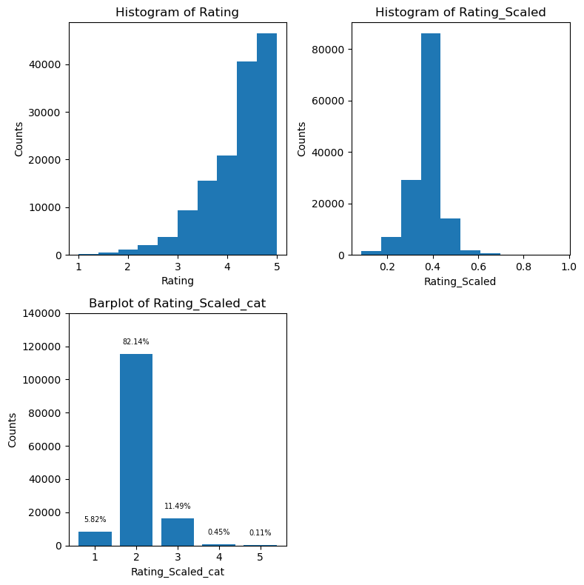
Distribution of Raw & Scaled Ratings
(1) Raw Ratings
(2) Scaled Ratings
Scaled Rating = Raw Rating/log (Rating Counts)
Scaled Tating is right -skewed,

Slide 4
Distribution of Scaled & Categorized Ratings
(3) Scaled_Categorized Ratings
Class Imbalance
Binary | Multi-class | Percent
Low (~88%) | 1 | ~5.8%
 | 2 | ~82%
High (~12%) | 3 | ~11.5%
 | 4 | ~0.45%
 | 5 | ~0.11%
Severe Class imbalance in Scaled & Transformed Ratings
Binary Classification (“1”, ”2”, ”3”-- “Low”
“4”, “5”--”High”)

Slide 5
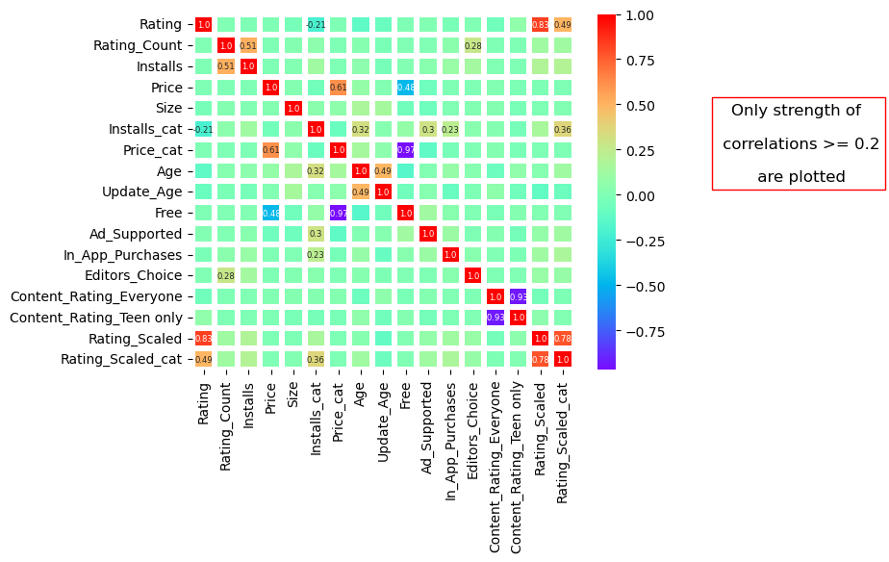
Correlation Heatmap Among Features
Only strnegth of Corerlation > 0.2
is annotated
1) A weak correlation between rating and installations, more frequently
installed Apps get higher ratings
2) Features that can boost installations: In-App purchase feature, Ads_Supported feature, Age of Apps

Slide 6
Raw & Transformations of Features in Classification
Features | Old Values | New Values
Install | Categorical | "under 1,000", "1,000 to 10,000","10,000 to 100,000", "above 100,000"
Content_Rating | Categorical | ”Everyone” , “Adult Only”, "Teen Only"
Size | Categorical | “K”“M”“V”
Price | Categorical | “Free”“<= $10”,“> $10”
Age* | Numerical | Time in Years from “Released” to Jun. 15th2021** Standardized by StandardScaler()
Updated_Age* | Numerical | Time in Years from “Last_Updated” to Jun. 15th2021** Standardized by StandardScaler()
Rating* | Categorical | Rating_Scaled= Raw Rating/log (Rating_Counts) Re-map Rating_Scaled into standard rating scales of 1-5
Editors_Choice | Boolean | Yes/No
In_App_Purchase | Boolean | Yes/No
Ads_Supported | Boolean | Yes/No
*New Calculated Features **Jun 15th2021 is when the data was scraped

Slide 7
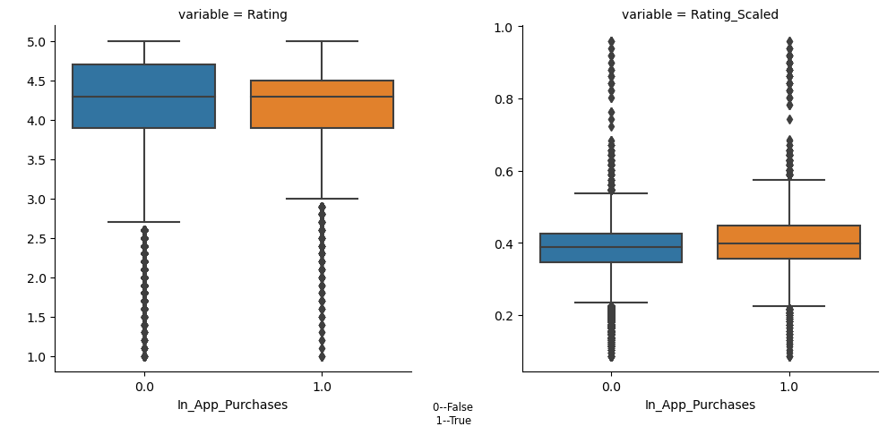
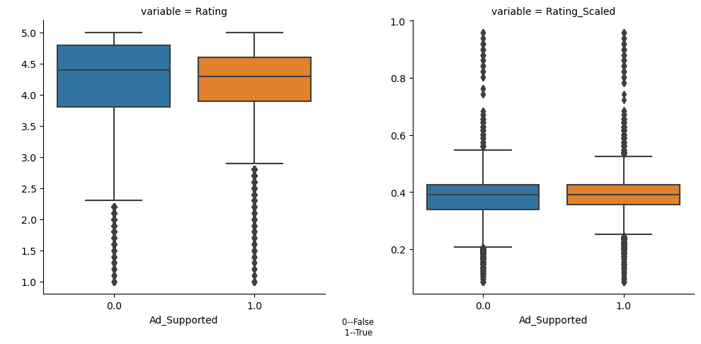
Expanatry Data Analysis
3)However, In-App purchase & Ads_Supported each by itself does not
show effect on App’s rating score

Slide 8
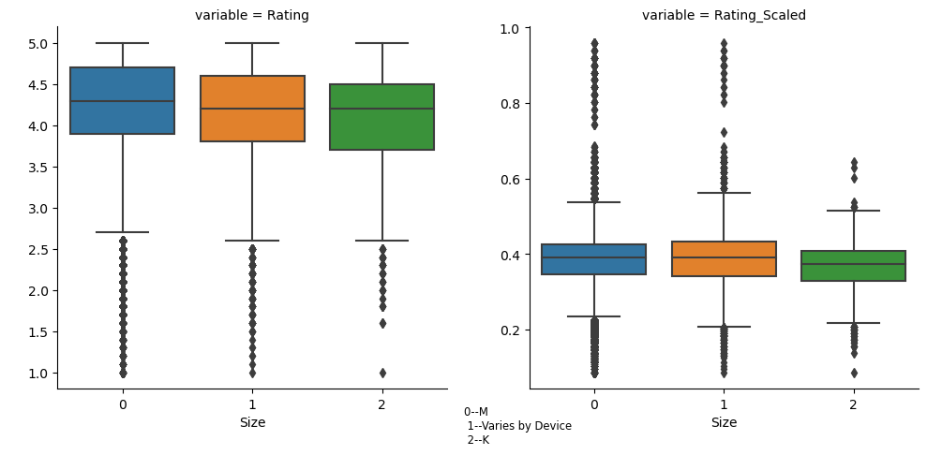
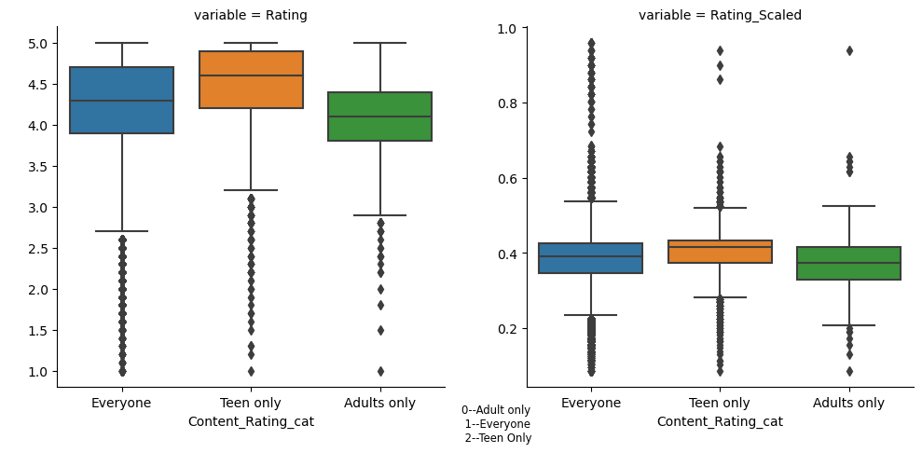
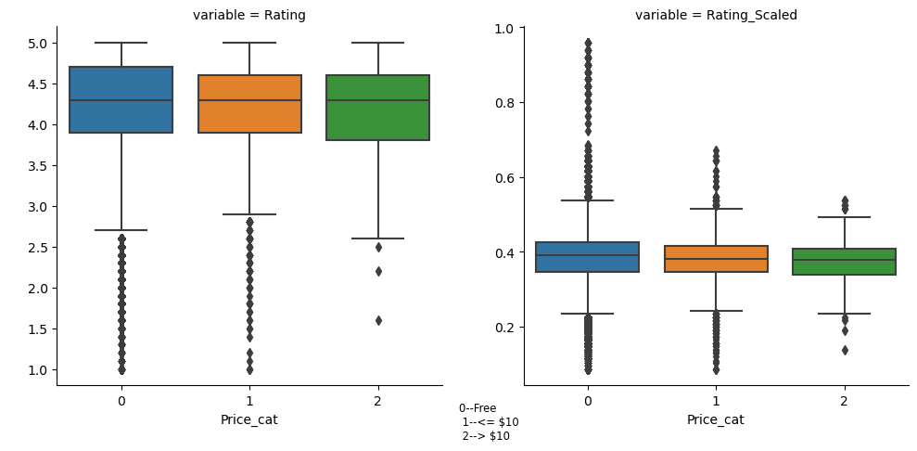
Expanatry Data Analysis
4) Size, Price & Content_Rating do not affect Rating

Slide 9
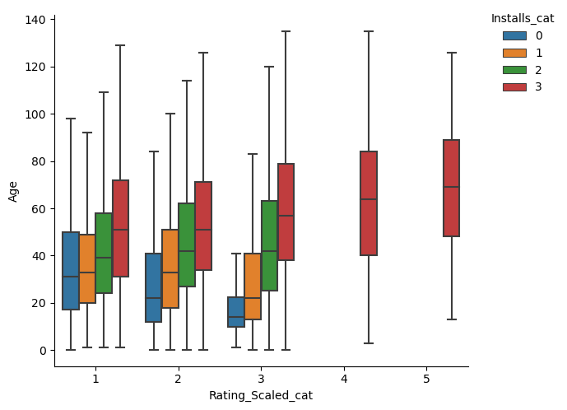
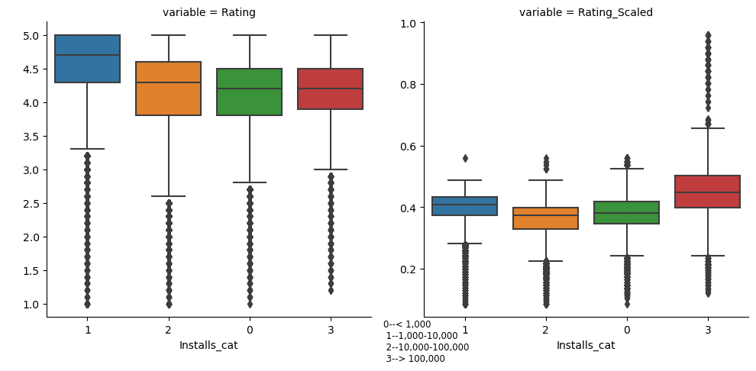
Expanatry Data Analysis
5) After controlling for installations, Age shows a postive relationship with Ratings, Older Apps have higher rating scores, which is especially true for Apps with installations above 100,000.

Slide 10
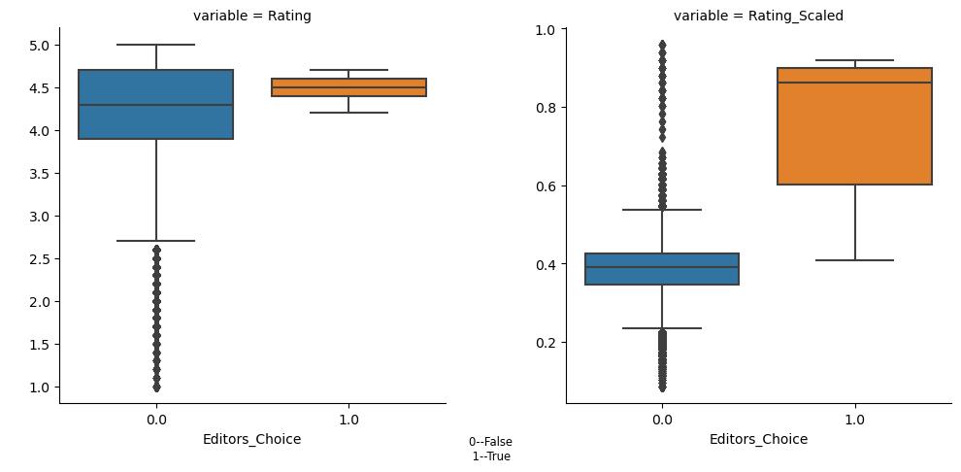
Expanatry Data Analysis
6) Being on the Editor’s Choice list is positively related to rating counts, which in turn entails higher rating scores.
7) Older Apps are updated less frequently and have longer duration since last updates.

Slide 11
Training and Model Selection
Features:
Ordinal Categorical Factors: Installstion, Size, Price
Nominal Categorical Factors: In_App_Purcahse, Ads_Supported,
Editors_Choice, Content_Rating
Numerical Features: Age, Updated_Age
Target Feature: Scaled/Categorized/Binary Rating
Classifiers:
DecisionTreeClassifier
RandomForestClassifier
GradientBoostingClassifier
Resampling:
RandomOverSampler
RandomUnderSampler
Hyperparameter Tuning:
RandomizedSearchCV

Slide 12
Modeling
Final Model:
GradientBoostingClassifier
Best Parameters:
{'under__sampling': {Calss “Low”: 55578},
'over__sampling': {Class “High”: 15225},
'n_estimators': 297, 'max_depth': 22,
'criteria': 'log_loss', 'learning_rate': 0.25}
Classification Results:
accuracy=0.89
Low scores for Class “High”
 | precision | recall | f1-score
Class “Low” | 0.93 | 0.94 | 0.94
Class “High” | 0.54 | 0.51 | 0.52
macro avg | 0.74 | 0.73 | 0.73
weighted avg | 0.89 | 0.89 | 0.89

Slide 13
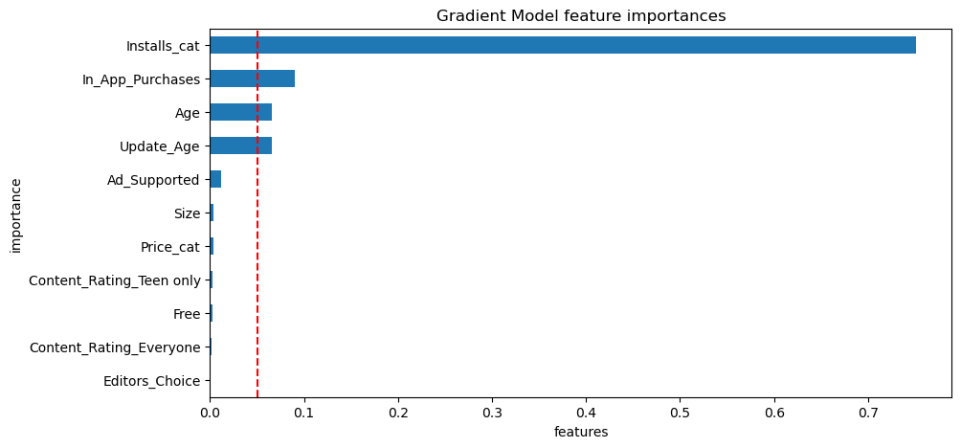
Importance of Factors in Determing Salary
0.05
0.05
The 3 Most Significantly Important Factors Ranked in Decreasing Order:
Installation, In_App_Purchases, Age, Updated_Age

Slide 14
Conclusion
App’s counts of “Installatons” is the dominant feature to forecast Rating
More installation means higher rating
The following can be manipulated to boosting Installations
Having in-App-Purchase Feature
Supporting Ads
Allowing time for Apps to grow and having longer history
Having In-App_Purchases, Having a longer history can also bring up Ratings but not as significant
Price, Size, Content_Rating have little or no effect on Ratings
Alternatives need to be explored to improve classification performance :

Slide 15
Discussion
Feature Engineering can be explored for possibly missed-out important features
Alternative metrics that could better measure quality of Apps than Ratings should be looked into
Finging alternatives as Target Feature:
e.g., Installation instead
Study other geners of Apps to gain some insights

